Slide 1
Winter Webinars 2024 with Ian Barker

Slide 2
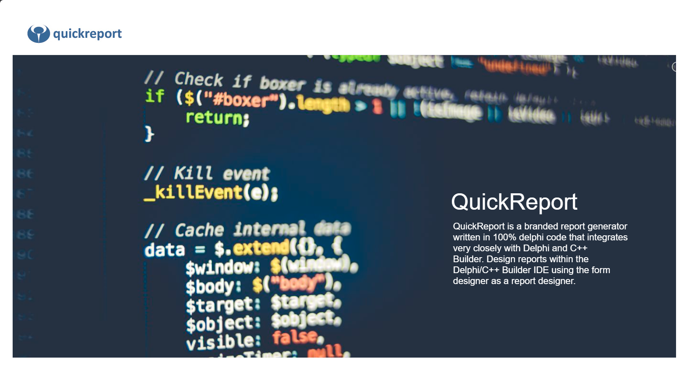
Winter Webinars 2024
with Ian Barker
QuickReport
is back!

Slide 3

Winter Webinars 2024 with Ian Barker
Ian Barker
Embarcadero Developer Advocate
ian.barker@embarcadero.com
about.me/IanBarker
Slides, link & replay: tinyurl.com/winter24qrp

Slide 4
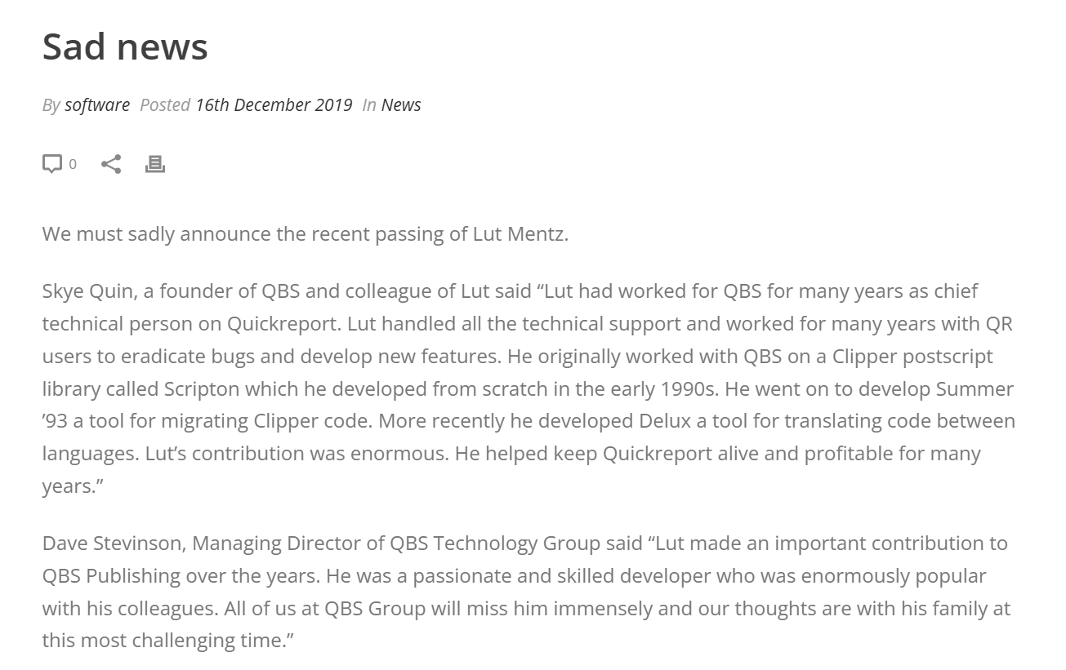
QuickReport – a brief history
Was the number one Delphi / C++Builder reporting solution for many years
The key developer, Lut Mentz, passed away unexpectedly
Owned by QBS Software
There is a website www.quickreport.co.uk by QBS but it is very out of date with incorrect information on it
Now distributed by an extremely reliable award-winning Embarcadero official partner

Slide 5
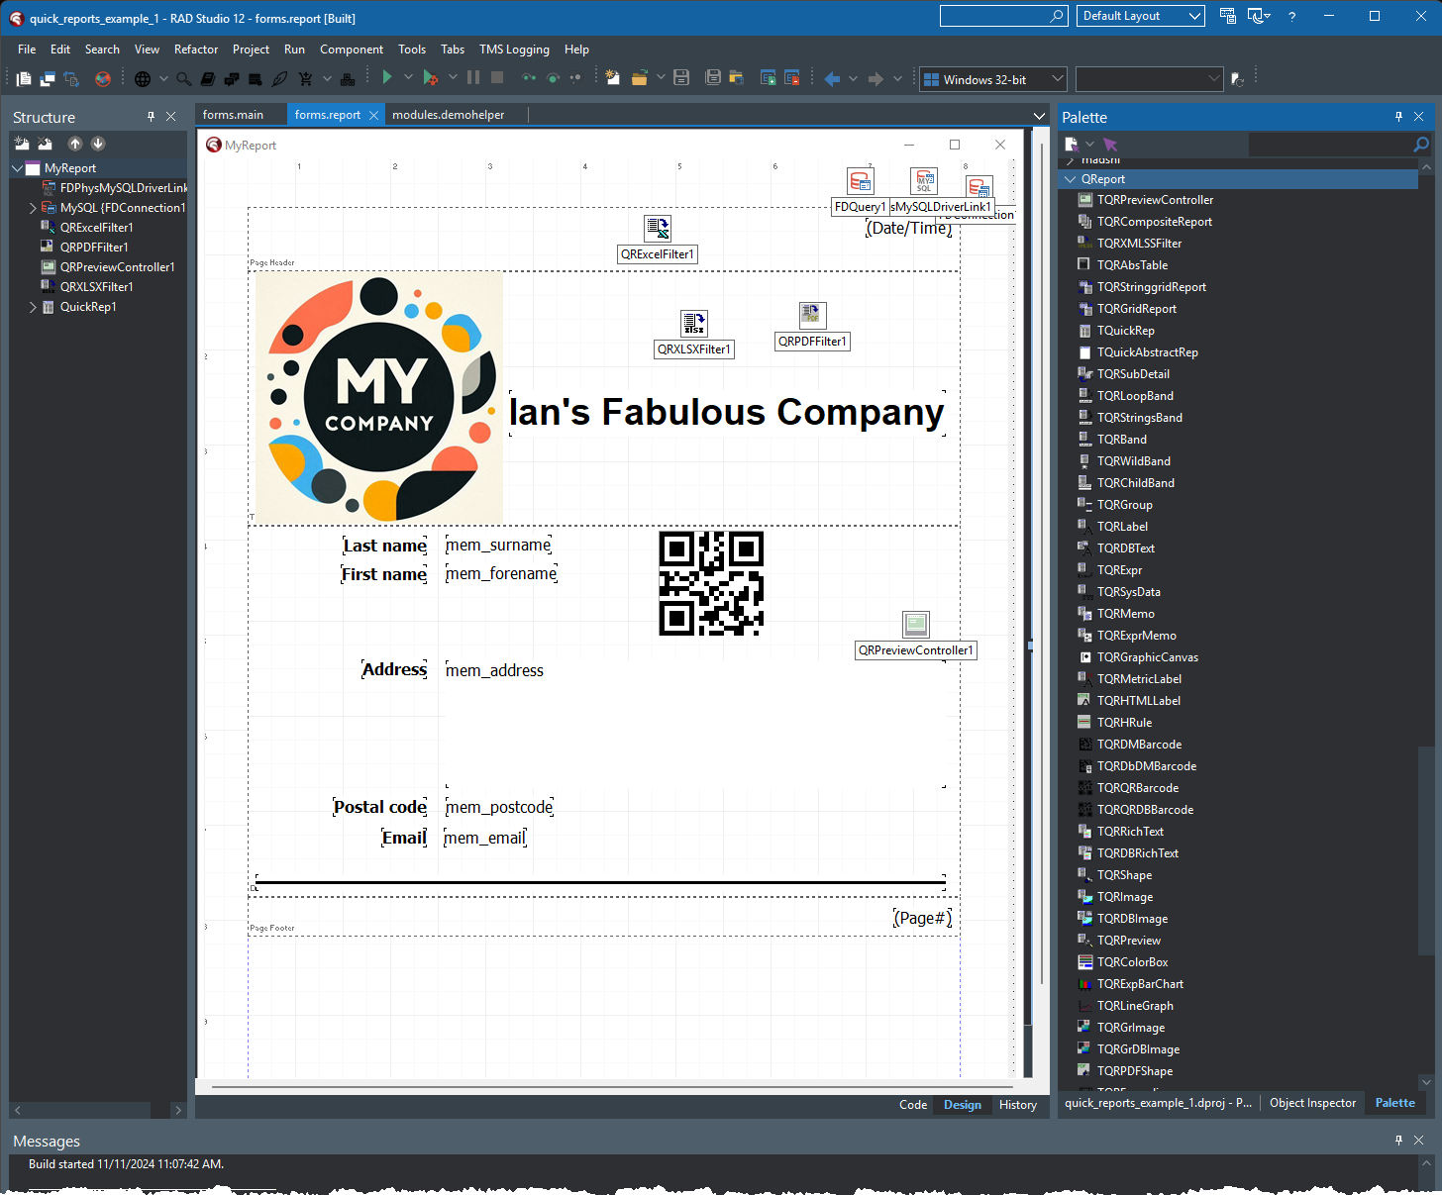
What is QuickReport?
QuickReport is a ‘banded’ report generator
It’s 100% Delphi code and works in Delphi and C++Builder
It supports all version of RAD Studio Delphi and C++Builder from version 7 up to the latest version 12.2
Doesn’t work in the CE versions 😢

Slide 6
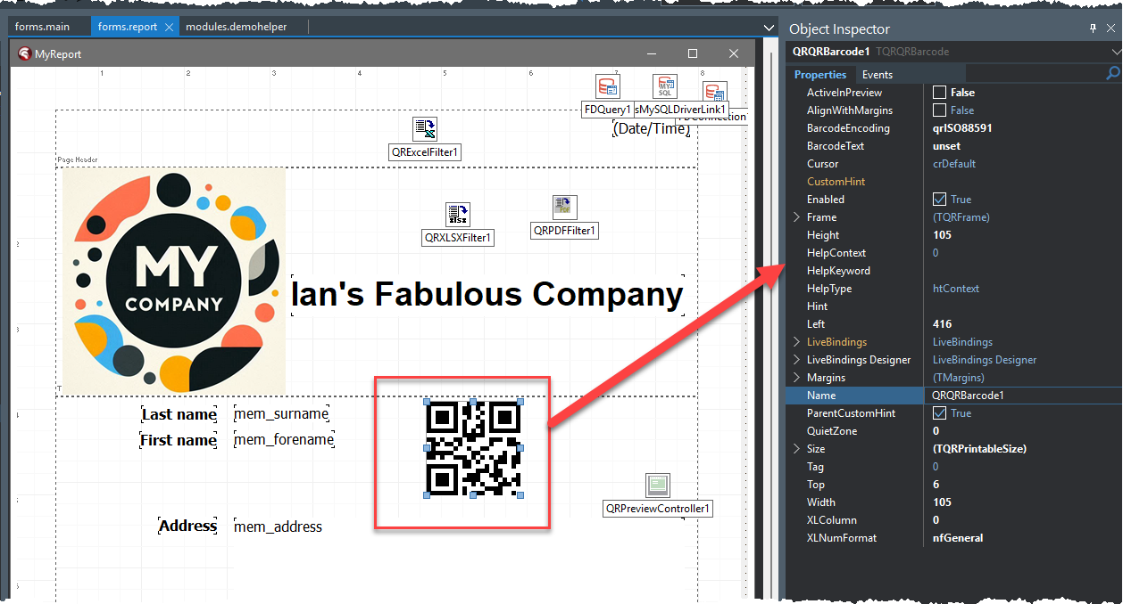
What is QuickReport?
You design reports in the IDE in the same way you design a form or screen
You create the report by adding a new form to your project, dropping on a TQRReport component
The you add QR controls like TQRLabel

Slide 7
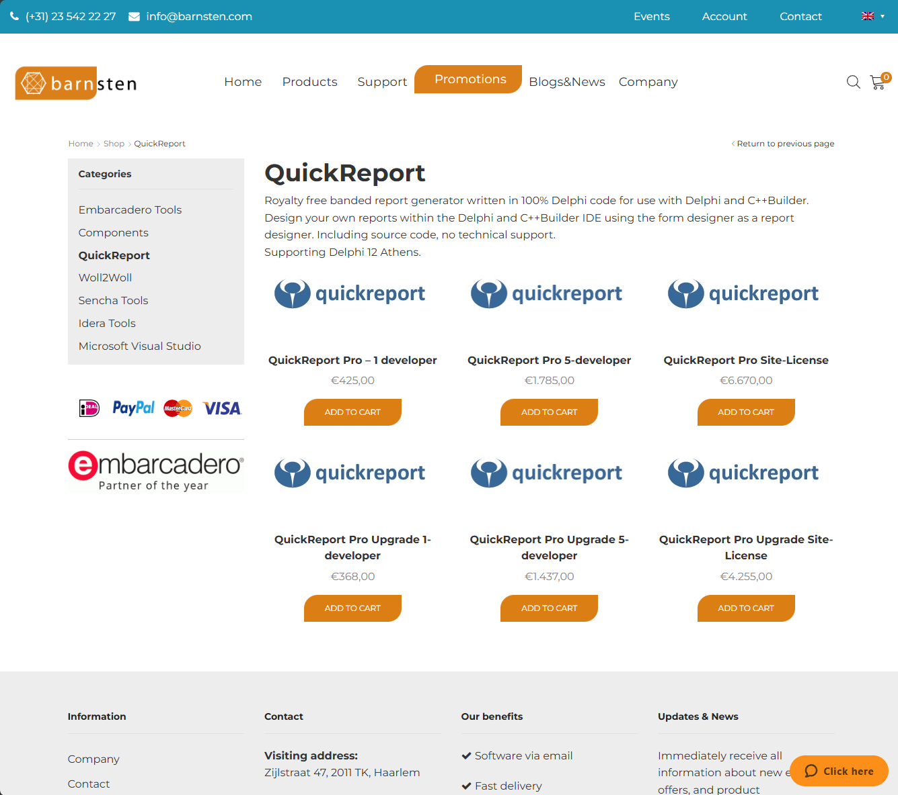
Where can you get QuickReport?
Exclusive distributors are
Embarcadero Partners Barnsten
barnsten.com/product-category/quickreport/

Slide 8
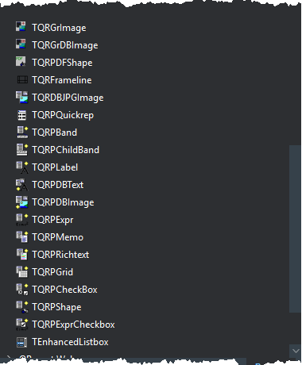
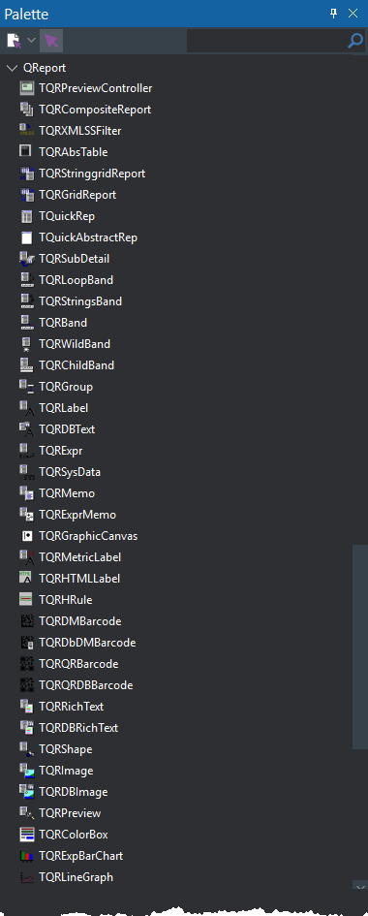
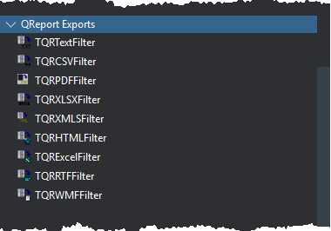
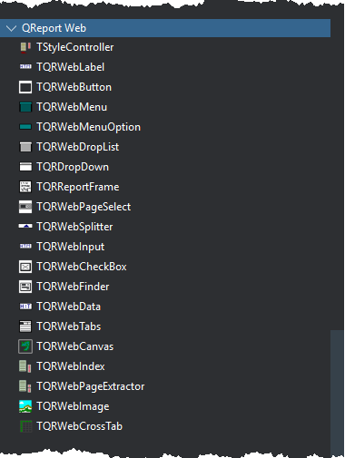
What is QuickReport?
There are a vast number of components included including data-aware, expression-based content, and barcodes
Also includes a wide selection of export components to output the report data/view to other formats such as PDF
New version includes a collection of HTML/web controls to generate web and server-side reporting applications

Slide 9
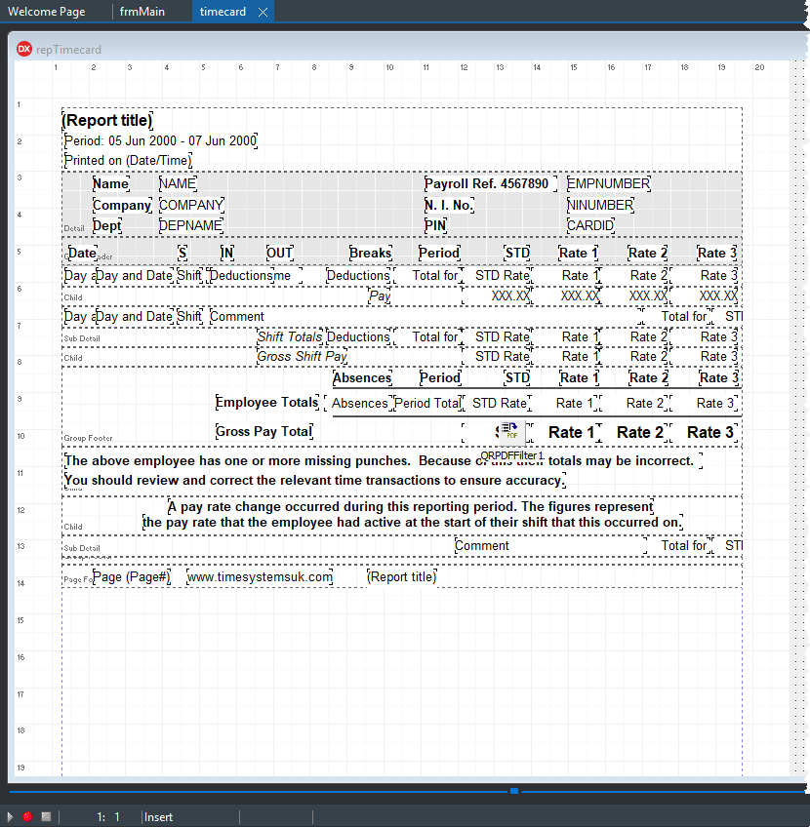
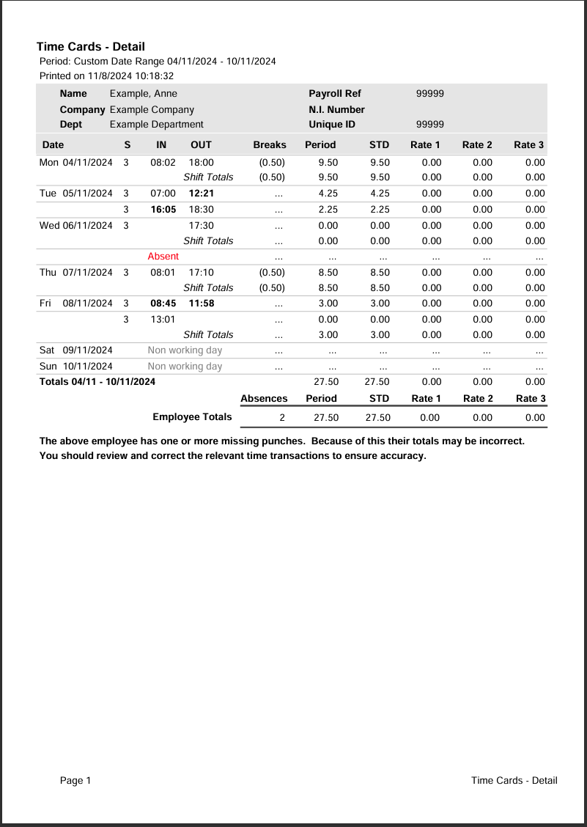
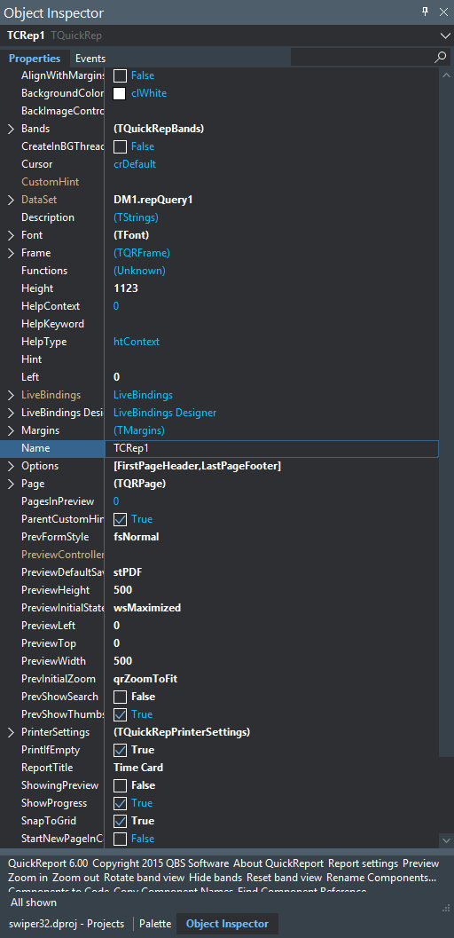

What is QuickReport?

Slide 10
Demo

Slide 11
Where can you get QuickReport?
Exclusive distributors are
Embarcadero Partners Barnsten
barnsten.com/product-category/quickreport/

Slide 12
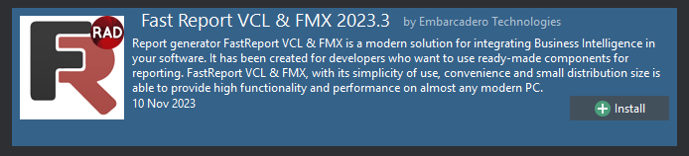
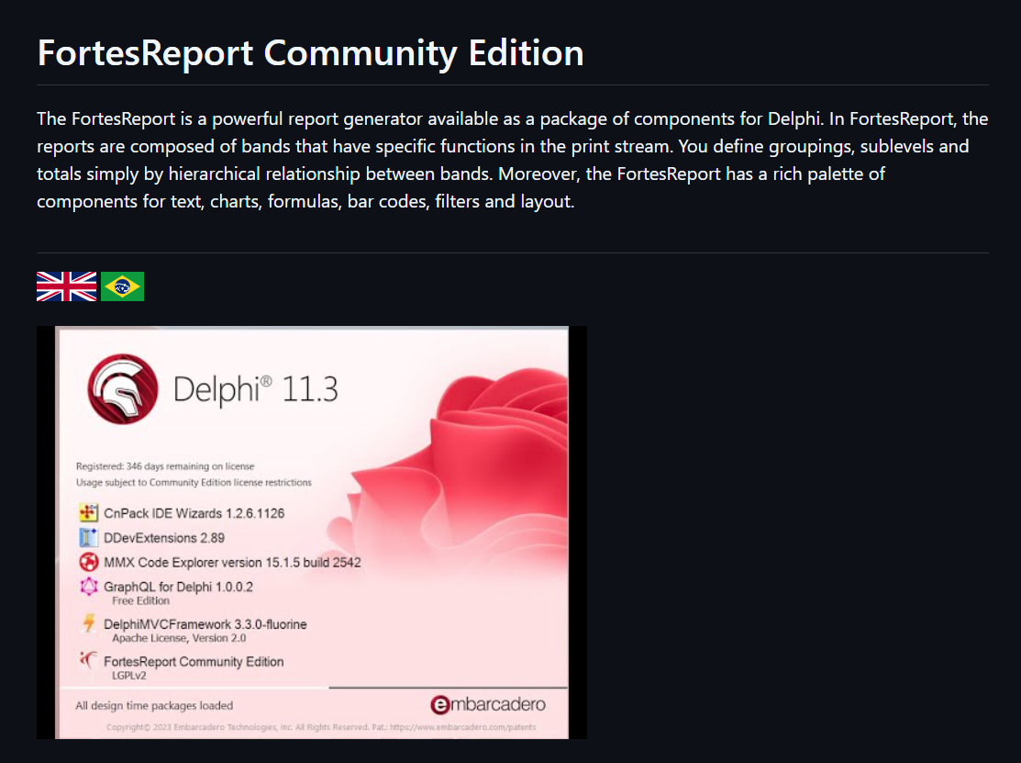
Other Reporting Options
Fast Report VCL
www.fast-report.com/products/fast-report-vcl
Fortes Report CE
github.com/fortesinformatica/fortesreport-ce

Slide 13
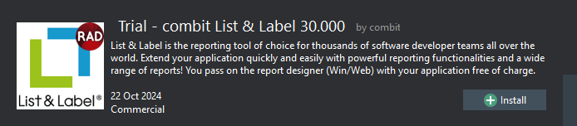
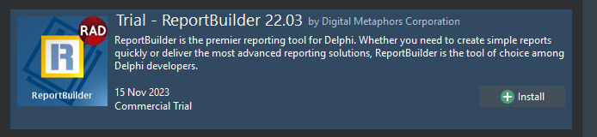
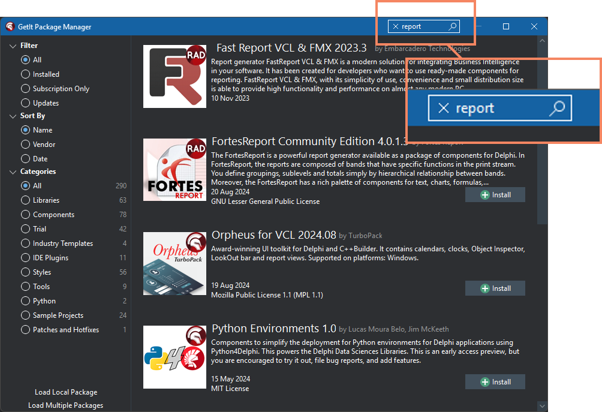
Other Reporting Options
List & Label
www.combit.com
ReportBuilder
digital-metaphors.com
You can find all of these and more in the GetIt package manager

Slide 14
Winter Webinars 2024
with Ian Barker
QuickReport
is back!

